Slide 1
Process and Thread Synchronisation Concepts
Lecture 4 of 4
Mutual Exclusion
Semaphores, Mutexes, Monitors
Producer/Consumer Problems
Events, Conditions and Rendezvous.
Note: Examples of the concepts presented here can be found in the RTExamples folder: Q6
You are encouraged to open the project(s) in Visual Studio and run the program(s)
Note: After today, please read lectures 11A and 11B on Canvas
©Paul Davies 2020. Not to be copied, used, or revised without explicit written permission from the copyright owner. This lecture may contain animations and is best viewed as a slide show

Slide 2
Further Process/Thread Synchronisation
Synchronisation, as we have seen is an important part of concurrent programming
Threads may need to be synchronised at the start or end of an application to ensure that each is ready or finished. Alternatively, synchronisation is needed to ensure mutual exclusion when sharing a non-sharable resource or during the production and consumption of data.
In the last lecture we saw how 3 parallel threads could be created to maximize parallelism while performing the calculation below.
B² – 4AC
The solution required a producer/consumer arrangement of semaphores to synchronise their actions
  A 1st thread that produces B²
  A 2nd thread that produces 4AC
  A 3rd thread that consumes the above and produces the final subtraction ‘-’
However, not all synchronisation problems can be solved using semaphores.
Sometimes we need a different solution. This brings us to the topics of this lecture which are Events, Conditions and the Rendezvous.

Slide 3
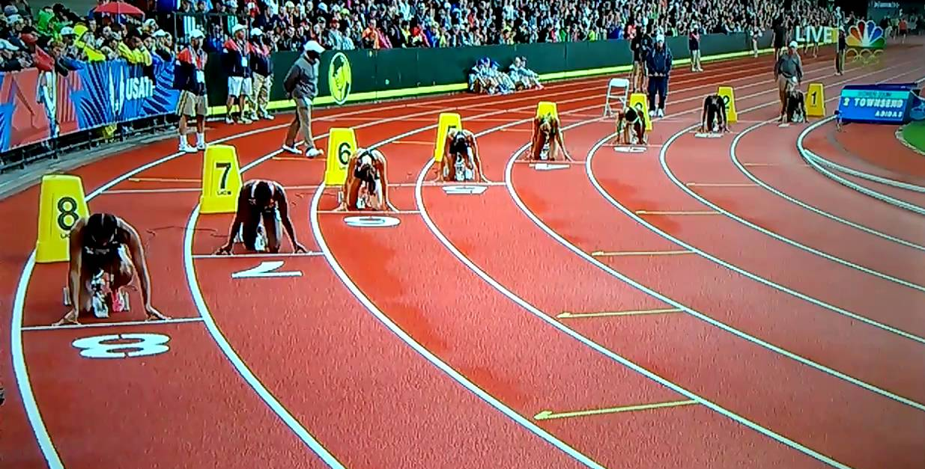
Events
An EVENT is a brief, or pulsed occurrence (i.e. infinitely short) of anything significant to the system which may affect its behaviour in some way.
Threads can be programmed to wait or synchronise to an event occurrence.
As an example, you can think of the start of race as an event which is signalled by the firing of a starter gun.
If you were at the start line when the gun went off, you could participate in the race, otherwise if you were stuck on the bus and missed the start, you would have to wait for the next race (i.e. next occurrence of the event).

Slide 4
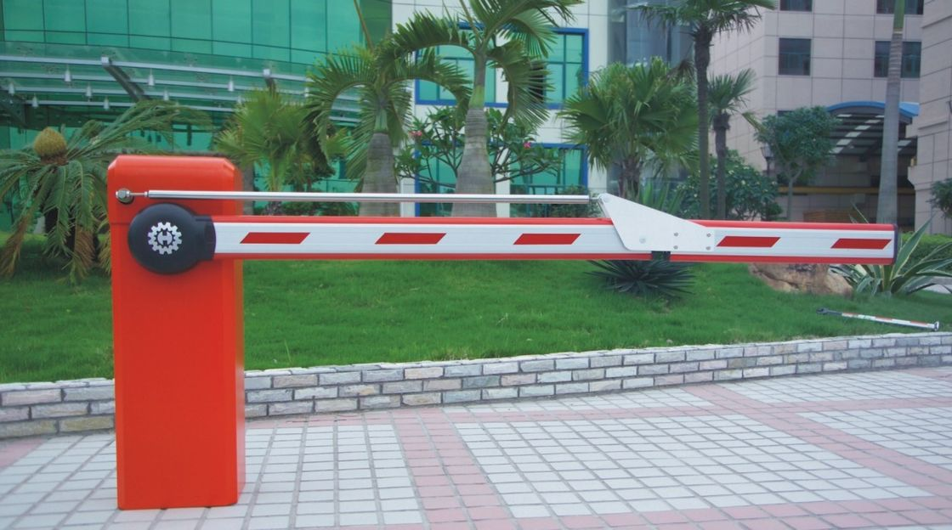
Conditions
A CONDITION is similar to an event, but persists for a measurable time period.
A condition it like a open/close gate. While the gate is open, anyone can proceed, regardless of when they arrive or how many times they attempt to pass through. When it is closed everyone must wait until the next time it is opened.
Questions: What conditions/events do passengers synchronise themselves to when using an elevator? What conditions/events does the elevator synchronise itself to?

Slide 5
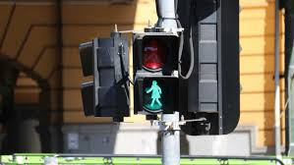
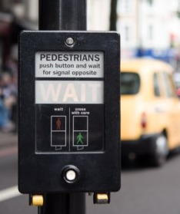
An Example
Event/Condition Problem.
A Traffic Light Controlled
Pedestrian Crossing

Slide 6
The Traffic Light Controller: Synchronised to an Event
The computer controlling the traffic lights at a crossing, could well have been programmed like this.
Here the computer waits for, or synchronises itself to a pedestrian generated event in the form of the “request” button being pressed. That is, pressing the button generates the event that the computer is waiting for.
Forever {
Set Pedestrian lights to STOP // remove walk condition for pedestrians
Set Vehicle Traffic lights to GO // signal the go condition for vehicles
WAIT for Pedestrian “cross” request // wait or synchronise to the button press
Set Vehicle Traffic lights to STOP // remove the go condition for vehicles
Set Pedestrian lights to GO // signal walk condition for pedestrians
Pause for 20 seconds
}
The Wait call above pauses the program each time around the loop preventing the software from continuously cycling through the Forever loop, stopping and starting traffic when there are no pedestrians waiting to cross.
Sync Point

Slide 7
Drivers: Synchronised to a Condition
As a driver we synchronise to the Red and Green traffic lights indicating the stop/go conditions which regulate our progress as we drive though crossings.
while (travelling along Broadway) {
Wait for the Green Traffic Light Condition
Drive through lights
}
Drivers wait for the green light condition and if present can continue, otherwise they have to stop.
While the green light condition exists, any number of cars arriving at the crossing are permitted to drive through as often as they like without the need to queue up or limit numbers.
The red/green traffic lights are just visual representations of a condition being in one of two states. A Red light means the condition is in the NOT signalled (i.e. blocking) state, a Green light means the condition IS in the signalled (non-blocking) state.
Sync Point

Slide 8
Pedestrians: Synchronised to a Condition
As pedestrians, we synchronise our crossing of the road to the lights at a pedestrian crossing using the stop/walk conditions.
while (wanting to cross Broadway) {
Wait for the Walk Light Condition
Cross road
}
We stop at the red light and wait for the ‘walk’ condition indicating that it is safe to cross.
While this ‘walk’ condition exists, any number of pedestrians arriving at the crossing are permitted to cross as often as they like without the need to queue up or limit numbers.
Again, the walk/don’t walk lights are simply a visual representation of the two states of a blocked/non-blocked condition.
Sync Point

Slide 9
Questions: Could we use counting semaphores to act as the synchronisation mechanism for cars and pedestrians, i.e. would the ‘Waits’ in the previous pseudo code examples work if we applied them to a semaphore instead?
Points to Consider
What if several pedestrians press/signal the ‘request button’ at more or less the same time?
Is this the same or different to pressing button once. Are we counting presses?
How many pedestrians are allowed to cross the road when the ‘walk’ indicator is illuminated?
What if pedestrians arrive when the signal is already indicating “safe to cross”?
What happens if no pedestrians are waiting?
How many cars are permitted to drive through when the Green light is illuminated?
What if cars arrive when the signal is already green?
What happens if no cars are waiting?

Slide 10
Analysis
Imagine our Pedestrians and Cars were threads (perhaps active objects)
A counting semaphore cannot solve this particular synchronisation problem because semaphores are designed to “count” which in turn permit only a ‘specified’ number of tasks to proceed when the semaphore is signalled. Any tasks made to wait, form a line, to be released in a first-in, first-out order.
This is not how a pedestrian crossing works. There should be no need to force pedestrians to cross the road one after the other, neither should there be a limit on how many are able to cross when the ‘walk’ indicator is illuminated. Likewise there should be no queuing or limit to how many cars are able to pass through a set of traffic lights.
Any pedestrian that is waiting, should be allowed to proceed without delay, while the condition persists, even if they arrive some time after the condition was initially signalled (as long as it still persists). Ditto, Cars.
We can solve these synchronisation problems using events and conditions which act like non-counting ‘guns’ and ‘gates’ which can be opened/closed (rather than a semaphore that acts like a turnstile at a Canucks game or a counting barrier at the entry/exit of a parking lot).

Slide 11
The RT Library CCondition Class

Slide 12
Condition Synchronisation using Windows Kernel
You can think of a condition variable as being in one of two states, true or false, (signalled or non-signalled, non-blocking or blocking if you prefer).
When a condition is signalled, it will remain in the signalled (true or non-blocking) state. This means that any thread that arrives at the signalled condition and performs a Wait() on it, will not be suspended and can proceed immediately.
Likewise threads that were waiting at a blocked/non-signalled condition will all be released simultaneously as soon as the condition is signalled.
Once signalled, a condition will remain signalled until manually reset.
Importantly: Signalling a condition while it is already signalled has no effect (it simply remains signalled, unlike a semaphore which would have counted the number of signals).

Slide 13
CCondition Member Functions
Conditions have been encapsulated into the CCondition class in the rt.cpp library and are initially created in the Blocking/NON-Signalled state.
The CCondition class provides functionality to
  Create a Condition
  Wait for a Condition to be signalled
  Signal a Condition, i.e. to the non-blocking state.
  Reset a Condition, i.e. to the blocking state.

Slide 14
Demonstrating (Windows) Conditions Graphically
E
E
E
E
Threads ‘E’ Resets Condition
Thread ‘E’ Signals Condition
Thread Arrives and Waits on Condition
Let all Threads through
All Threads Blocked
A
A
B
B
C
Condition
C
D
D
Manual Reset + Set/Reset()

Slide 15
Solution to Pedestrian Crossing Problem : The Traffic Light Controller Thread
CCondition SafeToCross (“Walk") ; // create a named, global blocking condition
CCondition SafeToDrive ("Drive") ; // create a named, global blocking condition
void main(void)
{
while(1) {
SLEEP(5000) ; // 5 second delay between lights changing
SafeToDrive.Signal() ; // allow cars to drive over pedestrian crossing
SLEEP(10000) ; // wait 10 seconds
SafeToDrive.Reset(); // stop cars travelling through crossing
SLEEP(3000) ; // 3 second delay between lights changing
SafeToCross.Signal() ; // allow pedestrians to cross
SLEEP(15000) ; // wait 15 seconds
SafeToCross.Reset(); // stop pedestrians crossing
}
}
See Program Q6 - SynchronisationUsingConditionVariables in the RTExamples Folder

Slide 16
Solution to Pedestrian Crossing Problem : The Pedestrian and Car threads
UINT _ _stdcall Pedestrian (void *args) // thread to represent a pedestrian
{
while(1) { // do forever
SafeToCross.Wait() ; // wait for walk indicator
}
return 0 ;
}
UINT _ _stdcall Car (void *args) // thread to represent a car
{
while(1) { // do forever
SafeToDrive.Wait() ; // wait for drive indicator
}
return 0 ;
}
See Program Q6 - SynchronisationUsingConditionVariables in the RTExamples Folder

Slide 17
Waiting a specified time on a Condition - Timeouts
By default a Wait() call will wait forever for the condition to be signalled, but you can optionally specify a “time out period” and abandon the Wait() if it is not signalled within that time. You can figure out afterwards if the Wait() was successful or abandoned.
This can be useful when periodically polling a condition (e.g. because the thread has other things to do and cannot wait forever for that condition to be signalled). The example below shows how to do this
while(1) // set up a polling loop
{
if( Condition1.Wait (1000 ) == WAIT_TIMEOUT) // wait 1000ms max for condition to be signaled
{ // if wait abandoned it returns Wait_Timeout
SLEEP(2000) ; // wait maybe 2 seconds then try again
}
else {
do stuff required when Wait() NOT abandoned
}
}
Note the concept of abandoning a Wait() call after a specified time period also applies to Mutexes, Semaphores and Events.

Slide 18
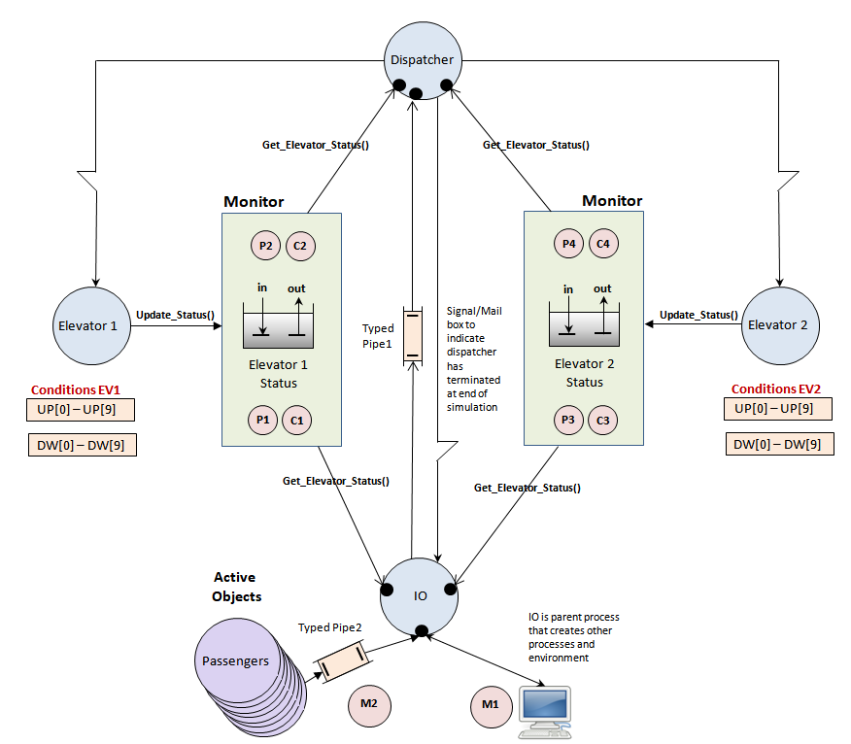
Conditions used in Assignment 1: What are they for and how do they work?
Think about the kind of synchronisation mechanism needed to limit the number of passengers on the elevator to 4

Slide 19
The RT Library CEvent
Class

Slide 20
Event Synchronisation using Windows Kernel
Events are encapsulated within the ‘CEvent' Class in the ‘rt’ library.
The CEvent class provides functionality to
  Create an Event (in the blocking state).
  Wait() for an Event to be signalled.
  Signal() an Event, i.e. unblock it and release waiting threads.
Note unlike a Condition, there is no Reset() function to reset an Event, as events are reset automatically after they have been signalled, i.e. in “zero” time.
However if no threads are waiting when an event is signalled, the event will remain signalled until at least one thread performs a wait on it, after which it will be allowed to pass and then the event is reset.
A process/thread can abandon its wait on an event by specifying a timeout period when Wait() is called, this would allow polling of the event at periodic intervals or to abandon the wait altogether it if does not happen within a certain time period. See example of this functionality applied to a condition on previous slides. The same principle applies.

Slide 21
Demonstrating (Windows) Events Graphically
When an event is signalled, ALL threads actually waiting for the event are released, upon which the event is immediately reset back to the blocking, non-signalled state.
Like a ‘gun’ indicating the start of a race, all competitors are allowed to go at the same time. There is no counting involving.
E
E
Thread ‘E’ Signals Event
No Threads Waiting: Event remains Signalled
Release all Waiting Threads
All Processes Blocked
A
D
C
B
A
B
C
Event
D
F
Thread Arrives and Waits on Event
F

Slide 22
CEvent ChassisReady ("ChassisInPosition") ; // a global event object
CEvent RobotFinished ("RobotDone", 0) ; // a global event object
UINT _ _stdcall ProductionLineThread (void *args) // thread to represent production line
{
while(1) { // do forever
SLEEP(5000) ; // simulate chassis moving into position
cout << "Production Line: New Chassis Arrived\n";
ChassisReady.Signal() ; // signal event occurrence
RobotFinished.Wait() ; // wait for robot to assemble car
}
return 0 ;
}
UINT _ _stdcall RobotThread (void *args)
{
while(1) { // do forever
ChassisReady.Wait() ; // wait for next chassis to arrive
cout << "Robot: Assembling Chassis\n" ;
SLEEP(5000) ; // simulate time delay due to assembling
RobotFinished.Signal() ; // signal robot has assembled car
}
return 0 ;
}
See Program Q6 - SynchronisationUsingEventVariables in the RTExamples Folder

Slide 23
The RT Library CRendezvous Class

Slide 24
The Rendezvous (or Barrier)
Another common synchronisation problem in concurrent systems occurs when several tasks need to synchronise to each other.
That is, all participating tasks must wait for the arrival of all other threads at the same sync point before all proceeding together. Like waiting for everybody to arrive for lunch or an exam, but you have to know how many are involved.
The act of all processes/threads arriving at the rendezvous and waiting will trigger it and allow them all to continue. Thus they wait for each other.
C++ ‘20 will incorporate the Barrier (basically a retriggerable rendezvous) as well as a Latch (a one time rendezvous), but their use is limited to threads in the same program, i.e. not between processes.
Rendezvous designed to synchronize 4 threads
A
A
‘A’ arrives and has to Wait() (for other 3)
B
B
‘B’ arrives and has to Wait() (for last one)
Rendezvous
C
C
Everyone has arrived so all can Proceed
D
D
‘D’ arrives and has to Wait() (for other 2)
4 threads working towards synchronization
All threads Synchronized

Slide 25
Example use of a Global Rendezvous object with 5 simple Threads
CRendezvous r1("MyRendezvous", 5) ; // a global rendezvous object designed to synchronise 5 threads
UINT _ _stdcall MyThread(void *args) // A thread function to use a rendezvous
{
while(1) {
. . . // do something before synchronising
. . .
r1.Wait(); // wait at the rendezvous point for other threads to do the same
. . . // do something after synchronising
. . .
} // repeat indefinitely
return 0 ; // terminate thread
}
int main()
{
// create 5 active threads
CThread t1( MyThread, ACTIVE) ;
CThread t2( MyThread, ACTIVE) ;
CThread t3( MyThread, ACTIVE) ;
CThread t4( MyThread, ACTIVE) ;
CThread t5 (MyThread, ACTIVE) ;
. . .
. . .
return 0 ;
}
(See Q6 - SynchronisationUsingARendezvous) in RTExamples Folder

Slide 26
Outline of the Rendezvous Class based on an Event
class CRendezvous {
int NumThreads; // number of threads participating in the rendezvous e.g. 5.
int NumberWaiting ; // number of threads still yet to arrive. Initially set to
// the value of NumThreads above e.g. 5
CMutex *RendezvousMutex; // a pointer to a mutex designed to protect above 2 integers
CEvent *RendezvousEvent ; // a pointer to an event object used to synchronise threads
public:
CRendezvous ( string Name, int SyncNumber ) { // Constructor needs the number of participating threads
NumThreads = NumberWaiting = SyncNumber ; // record number of threads using this rendezvous
RendezvousEvent = new CEvent (Name + "Event"); // make a named event in the constructor
RendezvousMutex = new CMutex (Name + "Mutex"); // make a named mutex in the constructor
}
~CRendezvous() {
delete RendezvousEvent ; // delete event in destructor
delete RendezvousMutex ; // delete the mutex in destructor
}
void Wait() { // all participating threads execute this when they arrive
RendezvousMutex->Wait() ; //enforce mutual exclusion while updating 2 int variables above
if(--(NumberWaiting) == 0) { // Decrement NumberWaiting and if I am last to arrive then I
NumberWaiting = NumThreads ; // reset the count of waiting threads back to the initial value
RendezvousEvent -> Signal() ; // and release all threads that have arrived, I don’t wait myself
RendezvousMutex -> Signal() ; // now release 1st of any blocked threads trying to Wait() at same time as me
}
else { // else, if I am NOT the last thread to arrive
RendezvousMutex -> Signal() ; // release any blocked thread trying to perform this Wait() at same time as me
RendezvousEvent -> Wait() ; // I wait here for the others to arrive and perform Wait() that will release me
}
}
} ;

Slide 27
The implementation of a rendezvous is fairly easy to understand.
All threads waiting to synchronise themselves perform a Wait() operation on the rendezvous object which in turn performs a Wait() on an initially blocking event inside the object.
As threads arrive and perform their Wait(), they decrement the variable NumberWaiting and provided they are not the last thread to arrive (i.e. that NumberWaiting is not equal to 0), they Wait() on the event blocking themselves.
When the last thread arrives it also decrements NumberWaiting but detects that it was the last one to arrive by the fact that NumberWaiting equals 0 . Thus, instead of performing a Wait() on the event, it instead Signals() the event, thus releasing those threads that are actually waiting. After that the event is immediately and automatically reset ready for the next rendezvous.
The Mutex is included to make sure that only one arriving thread is ever allowed to execute the rendezvous Wait() function at a time. This is to protect the integer NumberWaiting from two or more threads attempting to decrement it at the same time (a mutual exclusion problem).

Slide 28
Summary

Slide 29
When to use Events, Conditions, Semaphores or a Rendezvous
Use a Semaphore or Rendezvous when your thread synchronisation involves some kind of counting and/or queuing.
Use an Event or Condition when you are not interesting in counting/queuing
  A Condition should be used when you need to unblock other threads for a finite measurable period of time, which includes those currently waiting and those that arrive later, and when you want to have control over the resetting back to the blocking state.
  An Event should be used when you only want to unblock those threads that are already waiting, (or wait for at least one, if no one is waiting), since it is self-resetting.
A Rendezvous should be used when a specified set of threads need to wait for each other and nobody should need to take responsibility for detecting/signalling that everybody has arrived.

Slide 30
Question 1:
We looked in the last lecture on Producer/Consumer problems how we could synchronise 3 threads involved in the problem below
How would you synchronise these threads using a rendezvous?
  B² – 4AC
Question 2:
How would you synchronise processes and threads at the start and end of an application so that you knew that they were all up/running or, were waiting until they had all completed their task before terminating?
Many student experienced this kind of problem with earlier labs, e.g. creating process or threads and then trying the wait for them to complete or post them messages before they were even “alive”. At that time we introduced a SLEEP(2000) delay into the parent to give the OS the chance to create those processes/threads first.

Slide 31
Supplement: Events and Conditions in Posix and C++ 11
Posix and C++ 11 do not support Events (only Conditions) since they do not exist under all operating systems (e.g. Linux)
Posix and C++ 11 conditions are covered here (along with other topics - https://computing.llnl.gov/tutorials/pthreads/#ConditionVariables
http://www.cplusplus.com/reference/condition_variable/condition_variable/
Note: The operation of Conditions depends very much on each compiler and OS, so there may not be direct compatibility between one environment and other. This would be an area that would need close examination when porting code between OS platforms.

